Slide 1
Java Green
Online Food Website
Team:
Chanchal Vishwakarma – RA2211028010027
Animesh Garg - RA2211028010031
Vansh Batra - RA2211028010040
Devansh Om Saxena - RA2211028010051

Slide 2

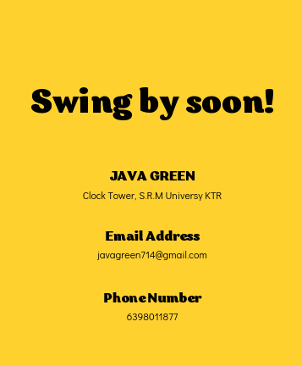
Content
Problem Statement
Abstract
Objective
Benefits
Database Benefits
Conclusion

Slide 3
Problem Statement:
Develop a food delivery website with a Database Management System (DBMS) for efficient storage and maintenance of user, restaurant, and order details.
Ensure the system can handle a large volume of data, including user profiles, menu items, order history, delivery tracking, and payment information.
Implement a secure and reliable database structure to maintain data accuracy, consistency, and integrity.
Enable rapid access and retrieval of data for users, restaurant partners, and administrators.
Ensure seamless integration with payment systems while adhering to data protection standards and regulations.

Slide 4
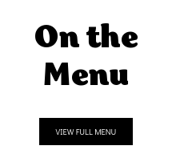
Abstract:
This project aims to develop a food delivery website integrated with a robust Database Management System (DBMS) to efficiently store, manage, and maintain user, restaurant, and order details. The system will focus on scalability, ensuring the ability to handle substantial data volumes while maintaining data accuracy, security, and integrity. Seamless integration with payment systems and a user-friendly interface will enhance the overall food delivery experience for customers, restaurants, and administrators. The project emphasizes data organization, improved decision-making capabilities, and data security, in compliance with relevant regulations, to foster trust and optimize operational efficiency.

Slide 5
Objective:
Develop a food delivery website with a Database Management System (DBMS) to efficiently store and manage user, restaurant, and order details.
Ensure scalability to handle large volumes of data while maintaining data accuracy and security.
Enable efficient data retrieval and seamless integration with payment systems.
Provide a user-friendly platform that optimizes the food delivery experience for customers, restaurants, and administrators.
Uphold data integrity and privacy standards to ensure the security of user and business information.

Slide 6

Benefits:
Sophisticated Data Access Control - Provide different views of the data to your employees, clients and suppliers. Control who can edit, add or delete data based on your business rules.
Safely Stored Data - As a fully managed solution there is no need to worry about data backups as they are included under your support contract.
Power & Flexibility - Sort and access to your web-based data in any way you choose using powerful generic search abilities. Change your system easily as your business needs change.
Scalability to accommodate business growth without compromising performance or user satisfaction.
Seamless user experience with quick order processing, delivery tracking, and integrated payments.

Slide 7

Database Benefits:
Reduce the amount of time you spend managing data
Analyse data in a variety of ways
Promote a disciplined approach to data management
Turn disparate information into a valuable resource
Improve the quality and consistency of information
provides a central location for storing user information and business logic.

Slide 8
Conclusion:
In conclusion, the implementation of a comprehensive Database Management System within a food delivery website is pivotal for enhancing operational efficiency, user experience, and data security. By effectively organizing and managing user, restaurant, and order details, the system supports informed decision-making, seamless user interactions, and scalability to accommodate business growth. Ensuring data security and integrity further builds trust with stakeholders and aligns with regulatory standards. Overall, the incorporation of a robust DBMS is essential for optimizing the food delivery process and fostering sustainable business growth.

Slide 9
Thank you !!

